Slide 1








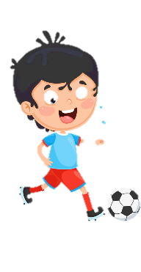
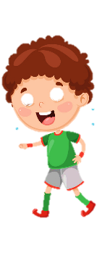











Notes:
Để nguyên trang bìa như này, chỉ thay đổi tên bài trong quá trình làm. Logo của sách Wonderful World

Slide 2

Warm up
Notes:
- Greet students.
- Sing “My family” song: https://www.youtube.com/watch?v=lGir6PUN-as
- Ask student to sing along.

Slide 3

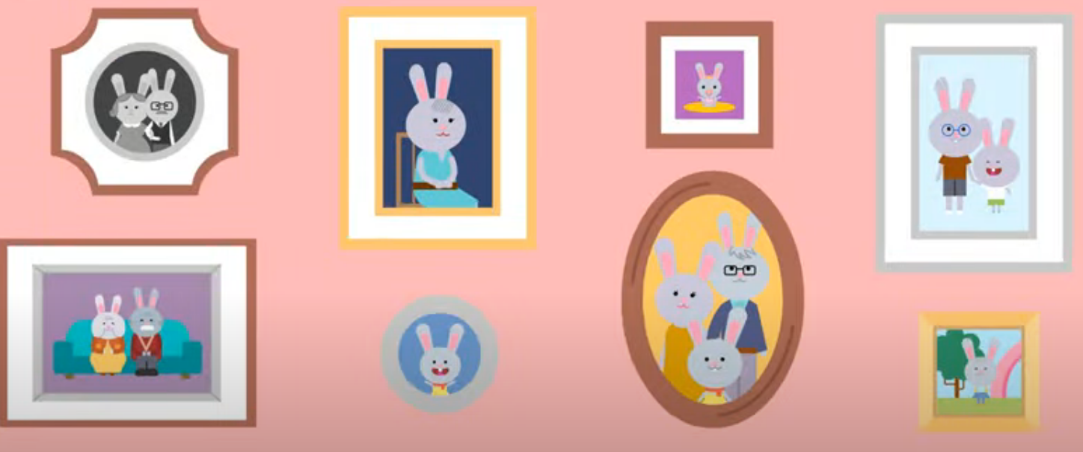
I love my family!
Notes:
https://www.youtube.com/watch?v=lGir6PUN-as

Slide 4


Slide 5
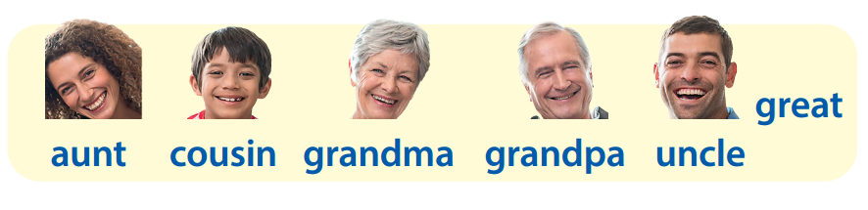

Review
Notes:
- Revise and practice functional language from lesson 2 with the flashcards.
- Then ask volunteers to stand at the front of the class and
ask and answer questions. (E.g: Who is this? – This is my ...)

Slide 6
Review
Who’s missing?
Who’s missing?
Who’s missing?
Who’s missing?
Who’s missing?
Notes:
Game: Who’s missing?
Divide the class into 4 groups.
Teacher shows the cards of family members on the board/screen.
Teacher hides a flashcard of a family member.
Ask each member to stand and say which picture is missing.
Who says it fast will get points for the teams.

Slide 7
Presentation

Slide 8


This is my brother Khoa.
Notes:
Lead in:
- Show a picture of your (teacher) family. Point to a member. Then say a name.
E.g: My brother is Khoa.

Slide 9
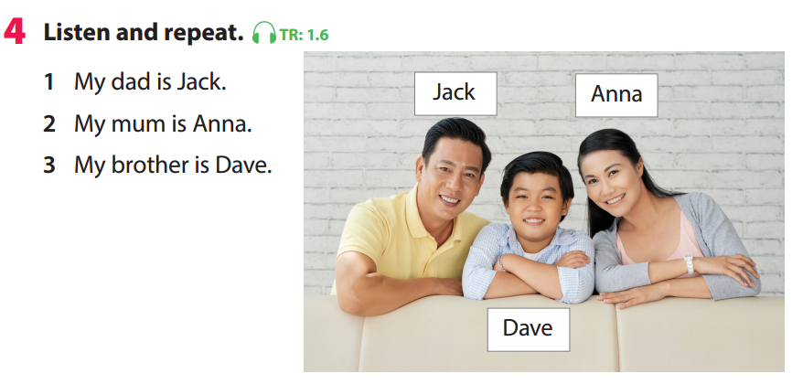
Notes:
Task 4: Listen and repeat. (Track 1.6)
- Point to the pictures. Ask students to notice the people and their names. Tell students that this structure can be used to introduce the names of the members in a family.
- Play the recording. Tell students to look at the pictures and follow the sentences with their fingers.
- Play the recording again. Ask students to repeat.

Slide 10


Slide 11

Practice

Slide 12
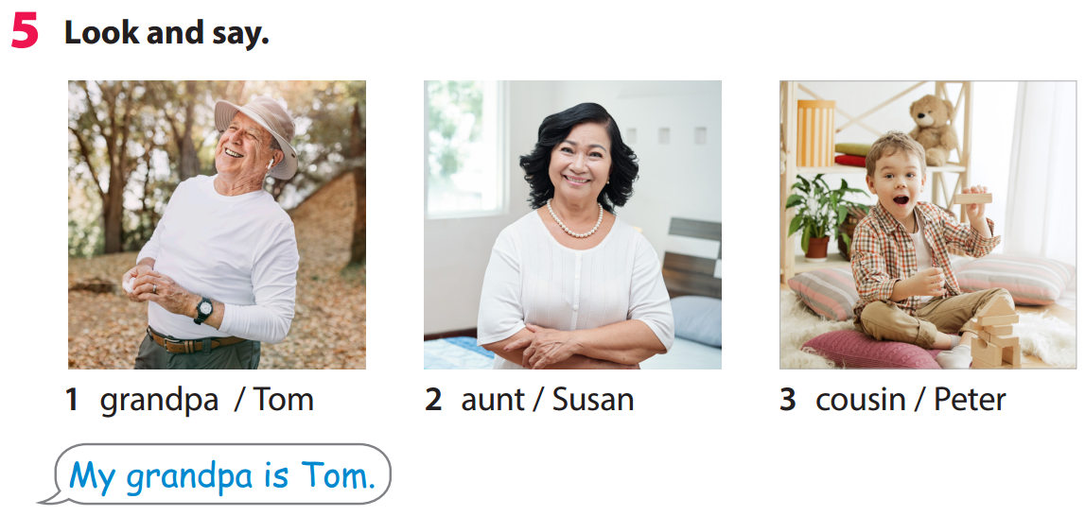
Notes:
Task 5: Look and say.
- Tell students to look at the picture for question 1 and ask them who the person in the picture is. Explain that Tom is his name.
- Read out the example and ask students to repeat.
- Explain the rest of the task to students. Ask students to practice saying the sentences individually and then in pairs.
- Ask volunteers to read out their answers. Correct any mistakes.
Suggested sentences:
2. My aunt is Susan.
3. My cousin is Peter

Slide 13



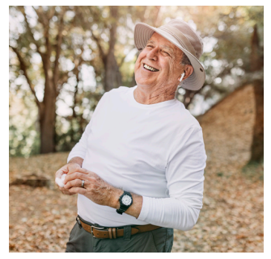
Tom

Slide 14
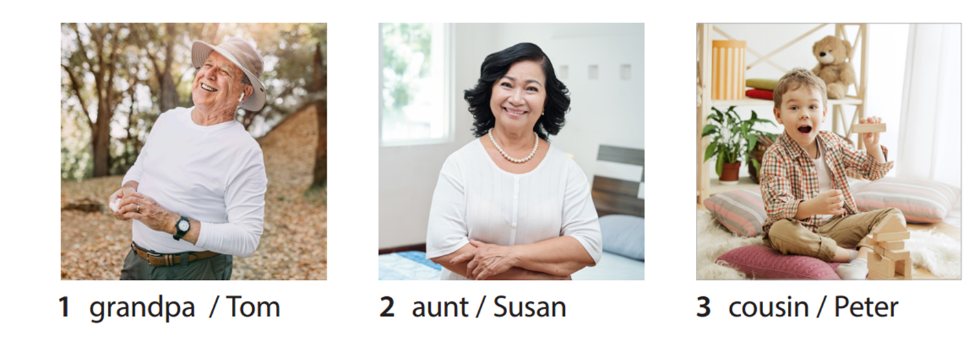
My aunt is Susan.

Slide 15
My cousin is Peter.

Slide 16






Slide 17



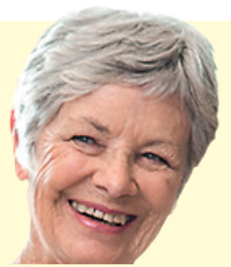
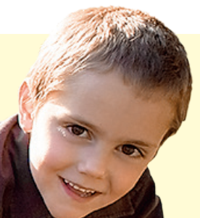

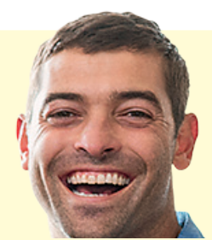


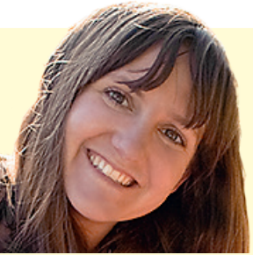
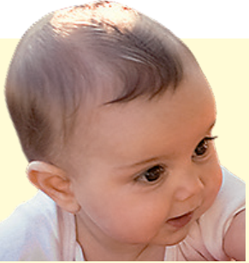

Go
Notes:
Mini game: Lucky memeber
- Divide class into 3 groups.
- Ask each group to choose one member they like, then say a structure to introduce the names of the members in their family.
E.g: My mum is Nga.
- The game will give students a random point if they answer correctly.
- Group has a most points is the winner

Slide 18




My aunt is
............

Slide 19

My cousin is ..........

Slide 20

My grandma is .........

Slide 21

My brother is .........

Slide 22

My grandpa is .........

Slide 23

My uncle is .........

Slide 24

My dad is .........

Slide 25
My mum is .........

Slide 26
My sister is .........

Slide 27
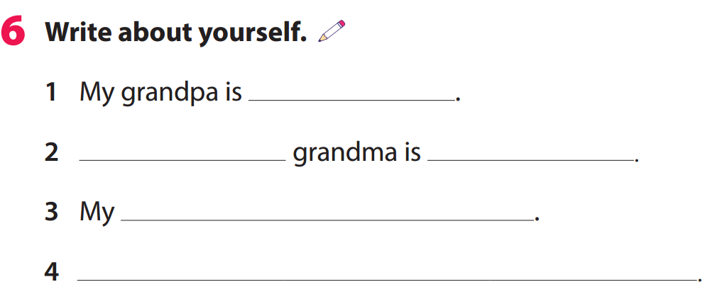

Notes:
Task 6: Write about your self!
- Tell them to look at the prompt. Elicit which information is missing in each sentence.
- Explain to students that they have to fill in the blanks with information about their family members.
- Ask volunteers to read out their sentences to the whole class.

Slide 28
Mike
My
Maria
sister is Nina
My uncle is Jack
Notes:
Example

Slide 29
Production
Notes:
My Family book.
- Tell students they’re going to make a family story book together.
- Ask student to draw/ glue a picture of member in this book. Then write the information about him/her.
E.g.: This is my ______
He is__________
Age: __________

Slide 30




MY FAMILY BOOK
Notes:
My Family book.
- Tell students they’re going to make a family story book together.
- Ask student to draw/ glue a picture of member in this book. Then write the information about him/her.
E.g.: This is my ______
He is__________
Age: __________

Slide 31

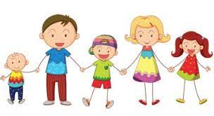
Notes:
My Family book.
- Tell students they’re going to make a family story book together.
- Ask student to draw/ glue a picture of member in this book. Then write the information about him/her.
E.g.: This is my ______
He is__________
Age: __________

Slide 32
Assessment

Slide 33
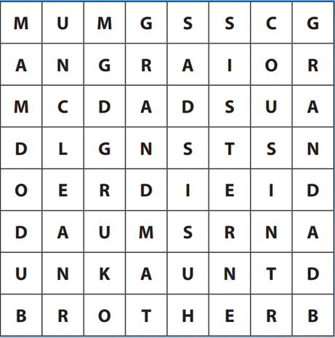
Word search
Notes:
- Give out worksheet. Then ask students to find and circle all of the direction words that are hidden in the grid.

Slide 34
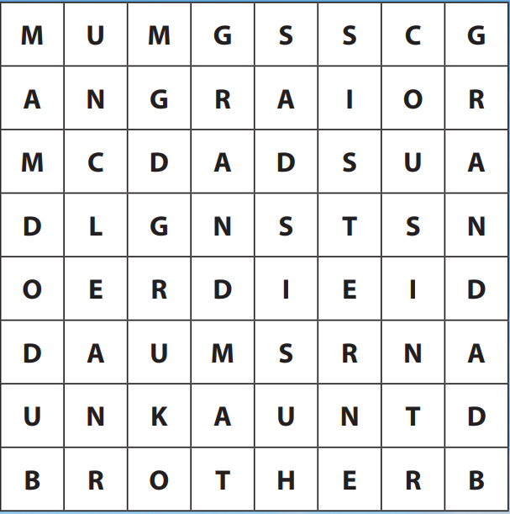

Slide 35
Goodbye!

